Slide 1

Driver Drowsiness Detection using Computer Vision Transformers (RT-DeTr)
20BCS073 Aadil Mohammad Hussain
20BCS019 Ebadul Islam Farooqi
Under the Supervision of
Dr. Sarfaraz Masood

Slide 2
Overview
Abstract
Motivation
Literature Review
Model and Method
Dataset used
Results & Performance Metrics
References
Conclusion
Output Demo

Slide 3
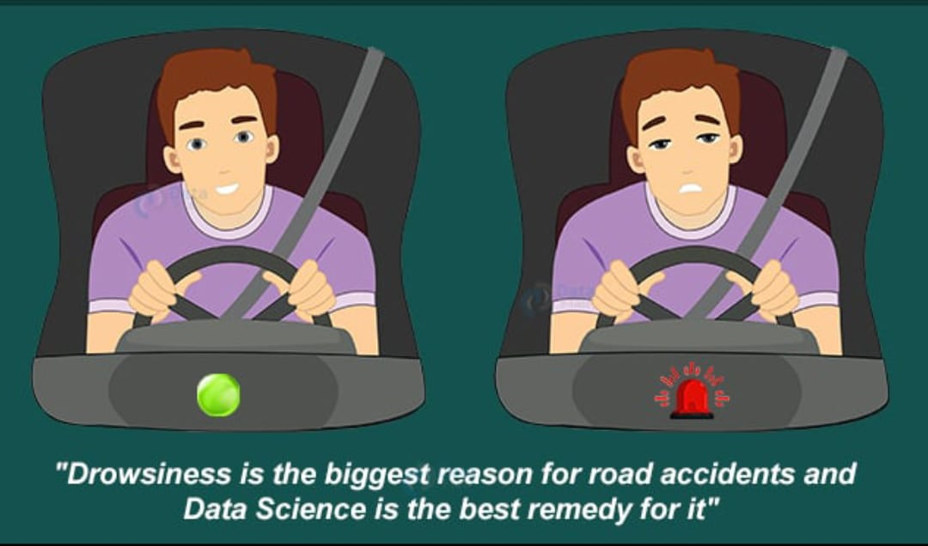
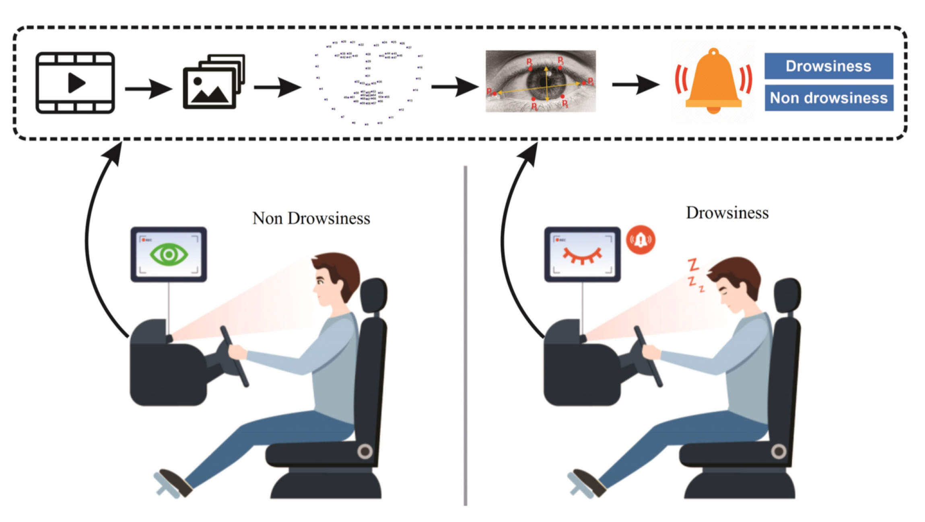
Abstract
Driver drowsiness detection is a crucial area of research aimed at reducing road accidents and fatalities caused by drowsy driving.
To address this issue, researchers have developed various methods for detecting driver drowsiness, including those based on biomedical signals, driver performance, and computer vision techniques applied to the human face.
By detecting drowsiness in real-time, systems can alert drivers and take appropriate measures prevent accidents, contributing to the reduction of traffic accidents and promoting road safety.
With the development in the field of Computer Vision Technique, implementing Driver Drowsiness Detection System has become more economical and easier. Hence we aim to achieve the same.

Slide 4
Motivation
The existing methods for driver drowsiness detection have some limitations.
Physiological-based methods can provide accurate and reliable measurements of drowsiness levels by directly measuring physiological signals, these methods can be intrusive and require specialized sensors and equipment, which can be expensive and impractical for real-world applications.
While the drawbacks of vehicle based methods for Driver Drowsiness Detection Systems include Limited Sensitivity, Inability to Detect Internal States, Vulnerability to External Factors. Hence researchers aim to implement Driver Drowsiness Detection Systems using Computer-Vision Techniques.
We ,in our project, aim to use RT-DeTr (Real Time Detection Transformers) as compared to traditional object detection models, RT-DeTr offers several advantages, including faster inference speed, higher accuracy, and better adaptability.
Companies & Organisations like NIH and NSF provide funding for research and development in the field of computer vision and artificial intelligence, which has contributed to the advancement of RT-DETR.

Slide 5
Literature Review
Title | Journal | Year | Description
Real-Time Driver-Drowsiness Detection System Using Facial Features [1] | IEEE Access | 2019 | The paper proposes a system called DiCare, which measures fatigue status by yawning, blinking and duration of eye closure. They propose a face tracking algorithm to improve the tracking accuracy. The experimental results showed that DriCare had accuracy around 92%.
Driver Drowsiness Detection Using Deep Learning [2] | Sensors | 2021 | The author puts forward a deep-learning based approach to detect the drowsiness of the driver. They achieve an accuracy of average 96%.
Real-time monitoring of driver drowsiness on mobile platforms using 3D neural networks [3] | Neural Computing & Applications | 2020 | The author uses depthwise separable 3D convolutions, combined with an early fusion of spatial and temporal information, to achieve a balance between high accuracy and real-time inference requirements.
DETRs Beat YOLOs on Real-time Object Detection [4] | Computer Vision and Pattern Recognition | 2023 | The author propose the Real-Time DEtection TRansformer (RT-DETR), to focus on maintaining accuracy while improving speed, followed by maintaining speed while improving accuracy.

Slide 6
Model and Method
The Real Time Detection Transformer (RT-DeTr) is a novel approach to driver drowsiness detection that leverages the power of Vision Transformers (ViT).
The model can be trained to recognize these signs and alert the driver or take appropriate actions to prevent accidents caused by drowsiness.
The input data for RT-DeTr can be images or videos. The RT-DeTr model is trained using labelled data, leading to better generalization and improved accuracy.
RT-DeTr is highly adaptable, supporting flexible adjustment of inference speed using different decoder layers without retraining. The model excels on accelerated backends like CUDA with TensorRT, outperforming many other real-time object detectors.

Slide 7
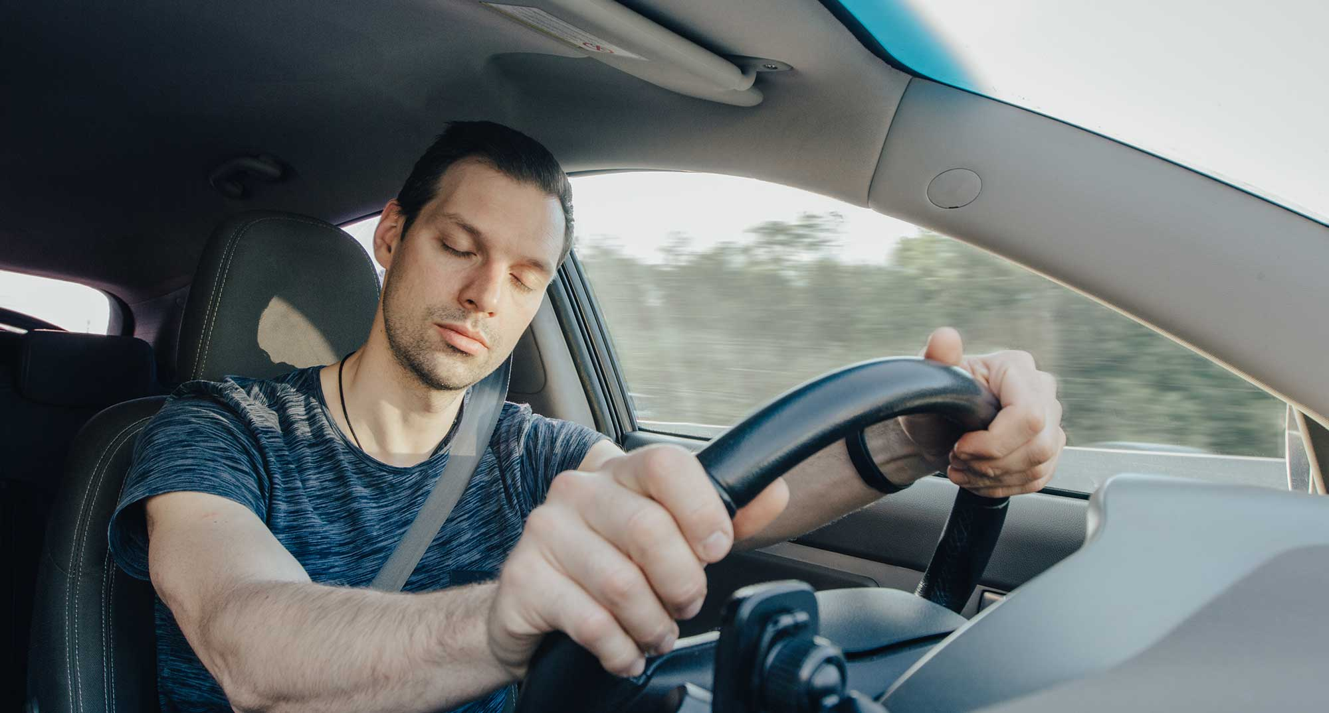


Work-flow of our DDD System
5 seconds
We detect whether the person is in a drowsy state or not. If he is in a drowsy state we monitor him for the next 5 seconds.
If the person stays in drowsy state, then we turn on the alarm.
The DDD system rings the bell until the person is awake
And we go back to monitoring the driver again once he is awake

Slide 8
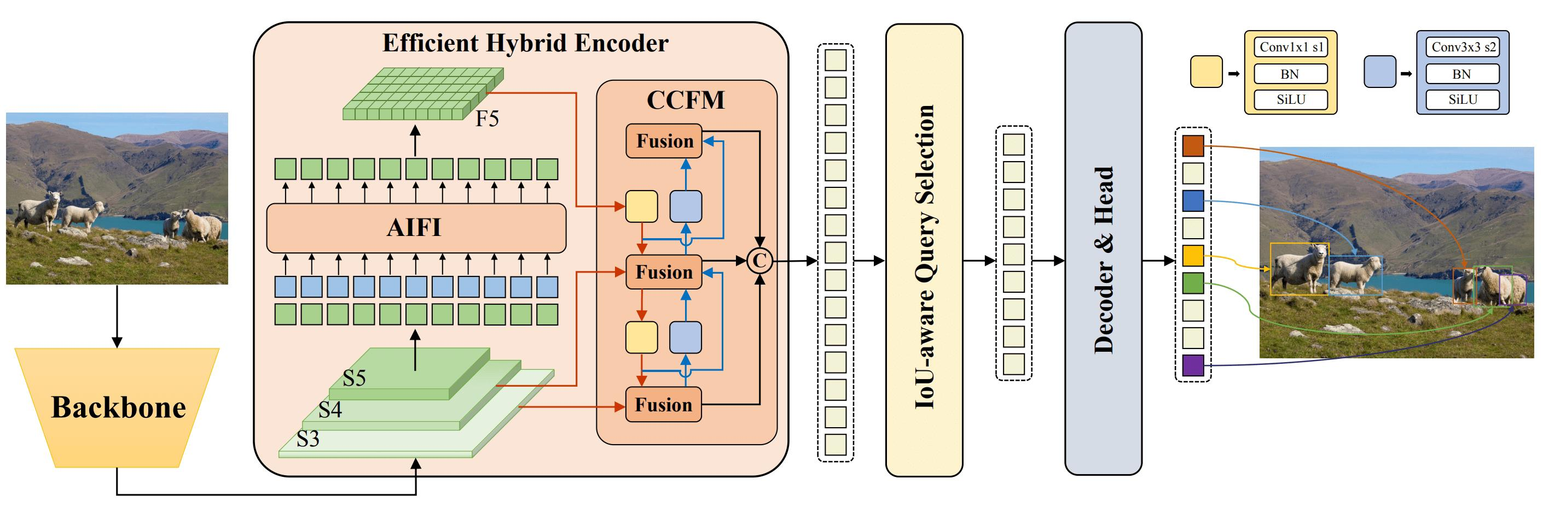
The RT-DeTr architecture comprises a backbone, a hybrid encoder, and a transformer decoder with auxiliary prediction heads.
The backbone is responsible for extracting features from the input data.
The hybrid encoder then processes these features and passes them to the transformer decoder.
The transformer decoder generates object detections using the extracted features.
The auxiliary prediction heads are used to refine the object detections and improve their accuracy.

Slide 9
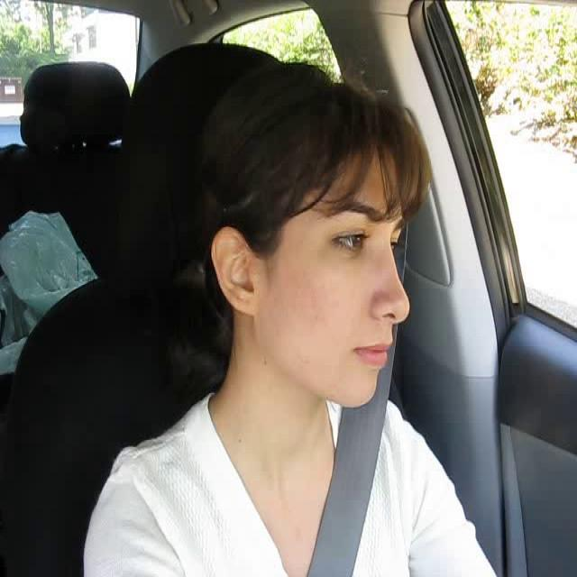
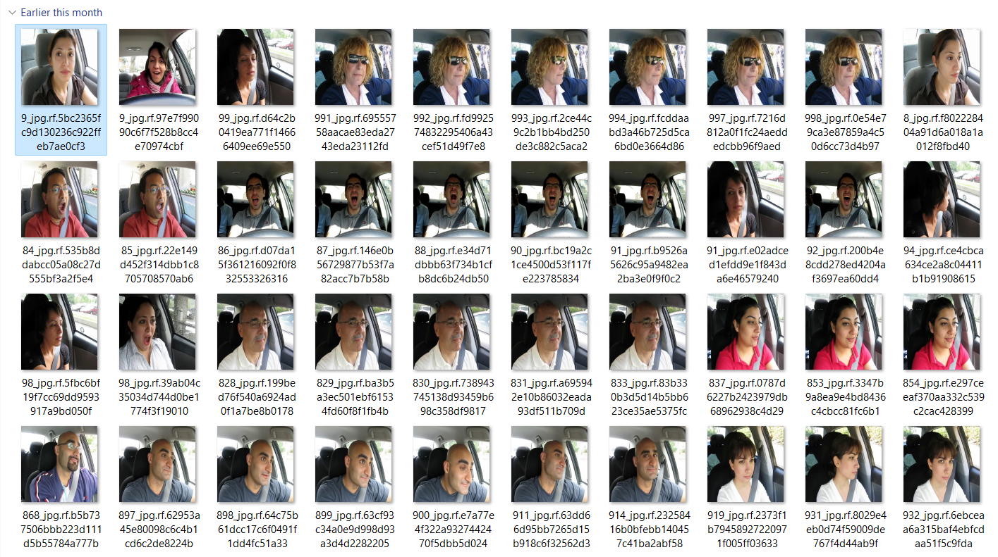
Dataset Used
640
We took 3,750 images
RGB Format
640
CLASSES: AWAKE, DROWSY
SOURCE OF THESE IMAGES ARE :-
Driver Drowsiness Detection Dataset present in Roboflow [5]
Driver Drowsiness Detection Dataset (DDD) by Ismail Nasri in Kaggle [6]

Slide 10
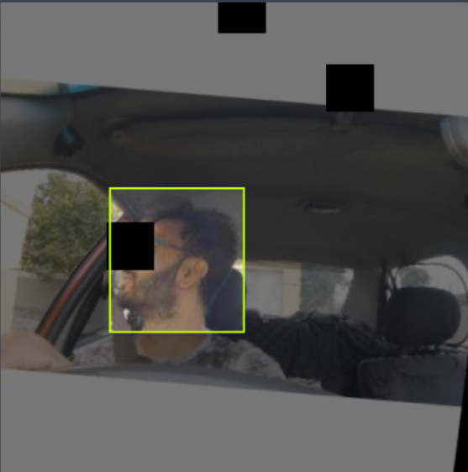
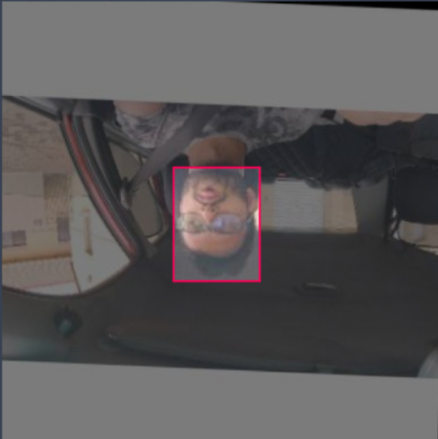
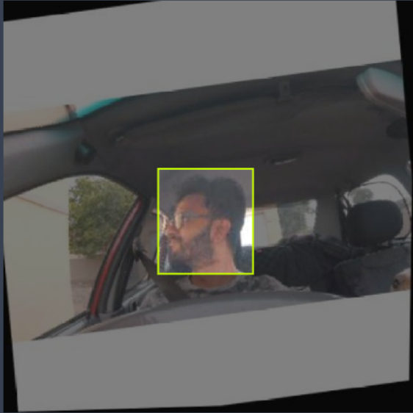

We also applied Augmentation Techniques on the given images
Cut-out Augmentation
Flip augmentation
Rotation augmentation
In the end after performing the necessary augmentation, our dataset looks like below

Slide 11
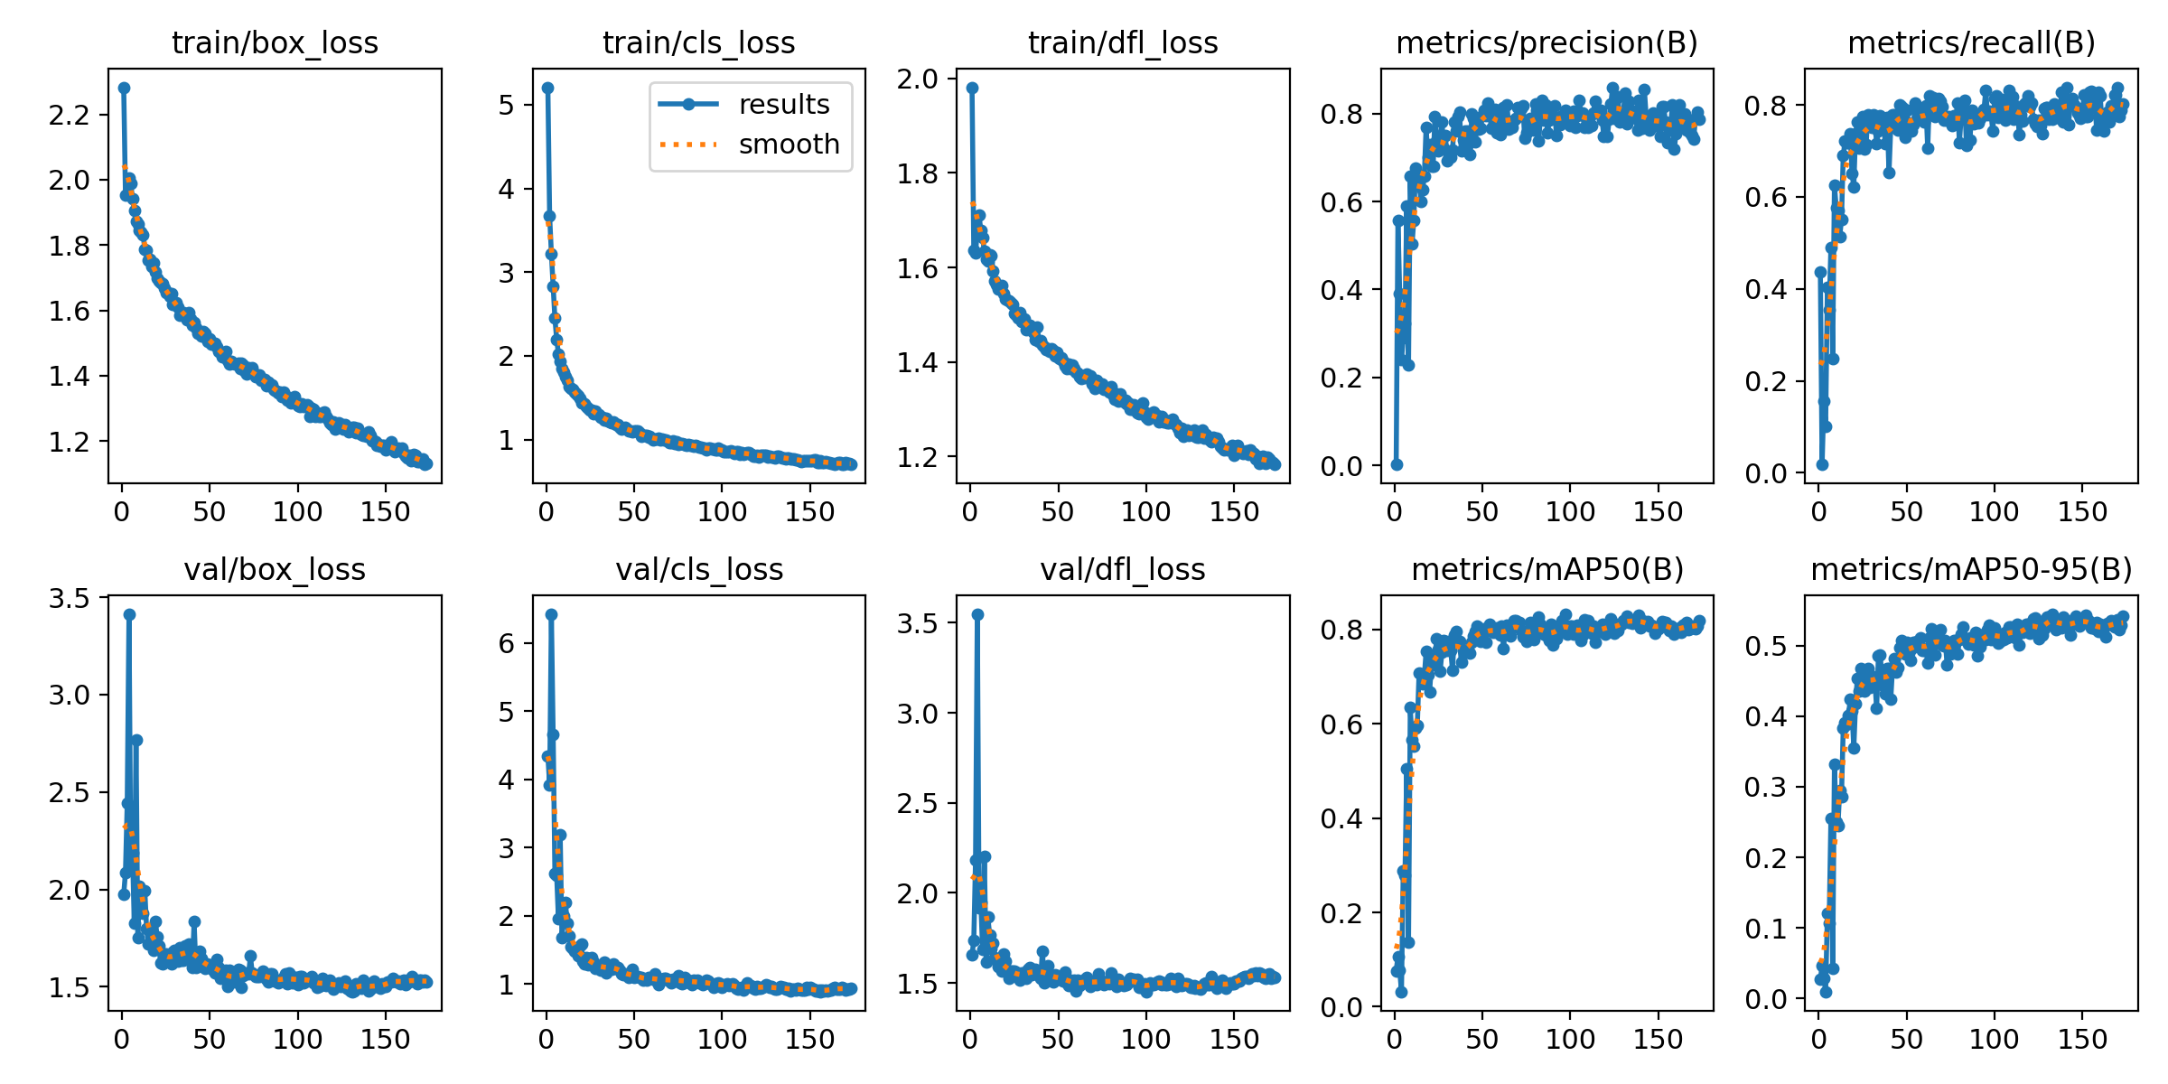
Performance Metrics
Precision = 83.01%
Recall = 76.6%
mAP = 81.5%
Precision – refers to the number the number of correct predictions among all predictions made
Recall – tells us what percentage of relevant labels were successfully identified
mAP - is the average precision metrics across all classes in the model.

Slide 12
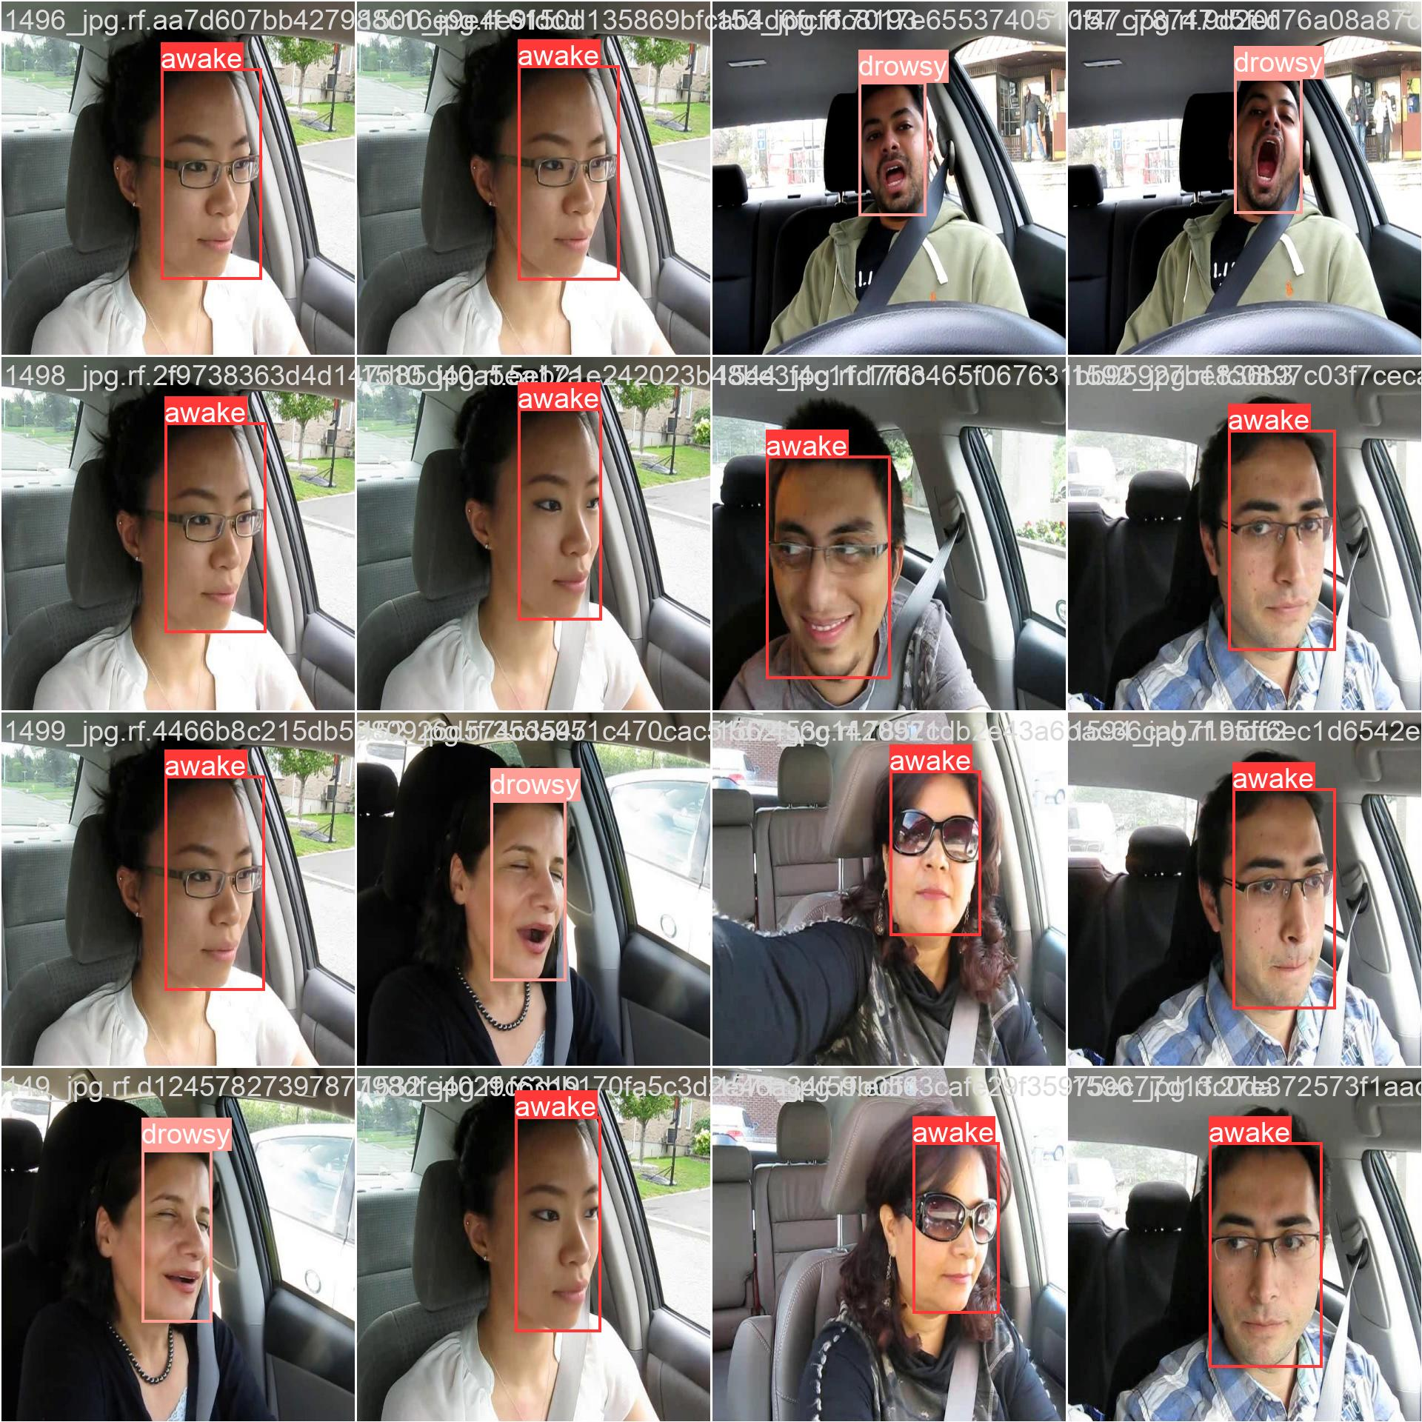

Results
Validation_Batch_Labels (Ground Truth)
Validation_Batch_Predictions made by the model

Slide 13
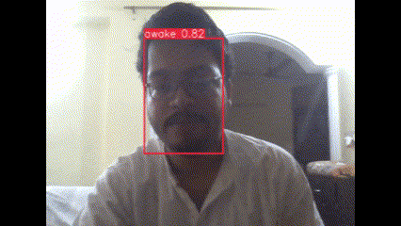
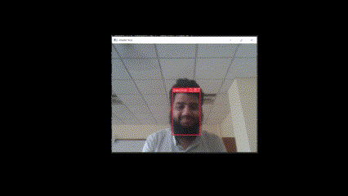
But one of the problems that we encountered after training the data, was that the model inference time came out to be pretty high (around 800-1000 ms) . Hence we were able to process one frame at each second from a 24 fps video, giving us a laggy output video with the following results.
We got to know that the processor of our laptop wasn’t powerful enough to process the given video and to remedy this problem we had to convert the given model into another format known as ONNX. The ONNX format model was able to run 3 times faster as compared to the model in Pytorch format. We also employed our GPU to speed up the process of inference.

Slide 14
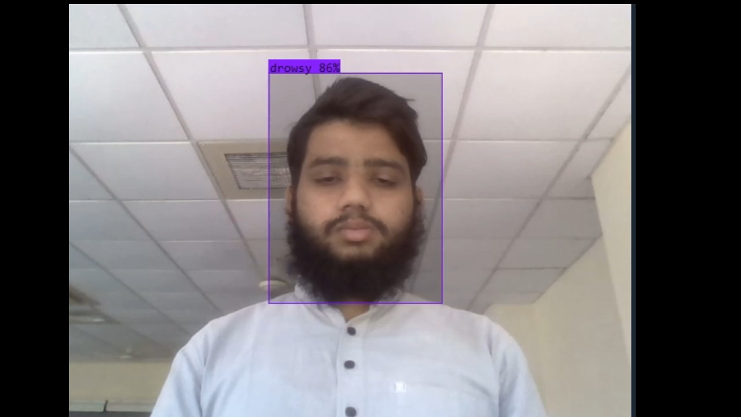
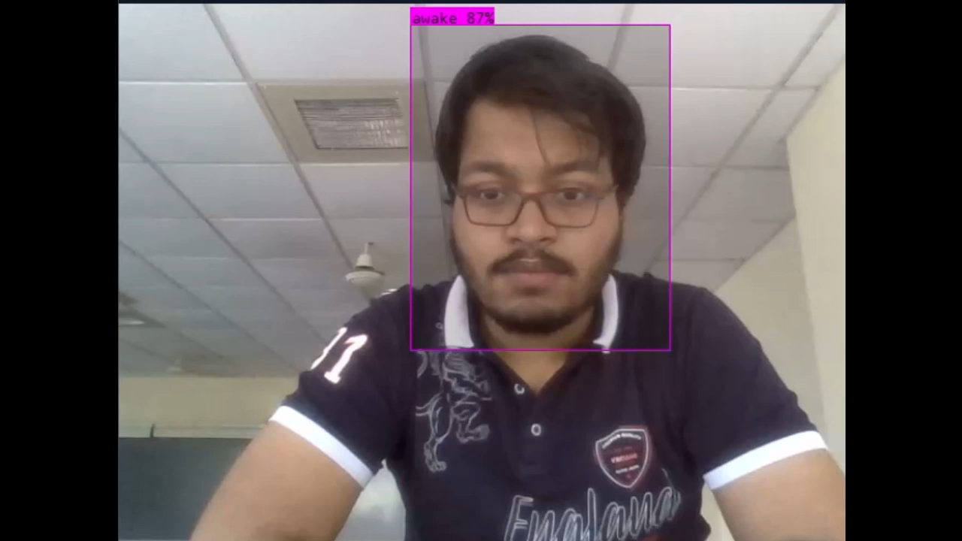
We deployed our given model on PC with NVIDIA GeForce RTX 1650. We were able to speed up the process with the help of its powerful and fast cores and amazing memory. The given output stream that we got was of around 15-16 fps. Much better than the 1-fps stream that we got with using CPU for inference. The ONNX “Open Neural Network Exchange” is an open representation format for machine learning algorithms which provide highly efficient performance across multiple platforms.

Slide 15
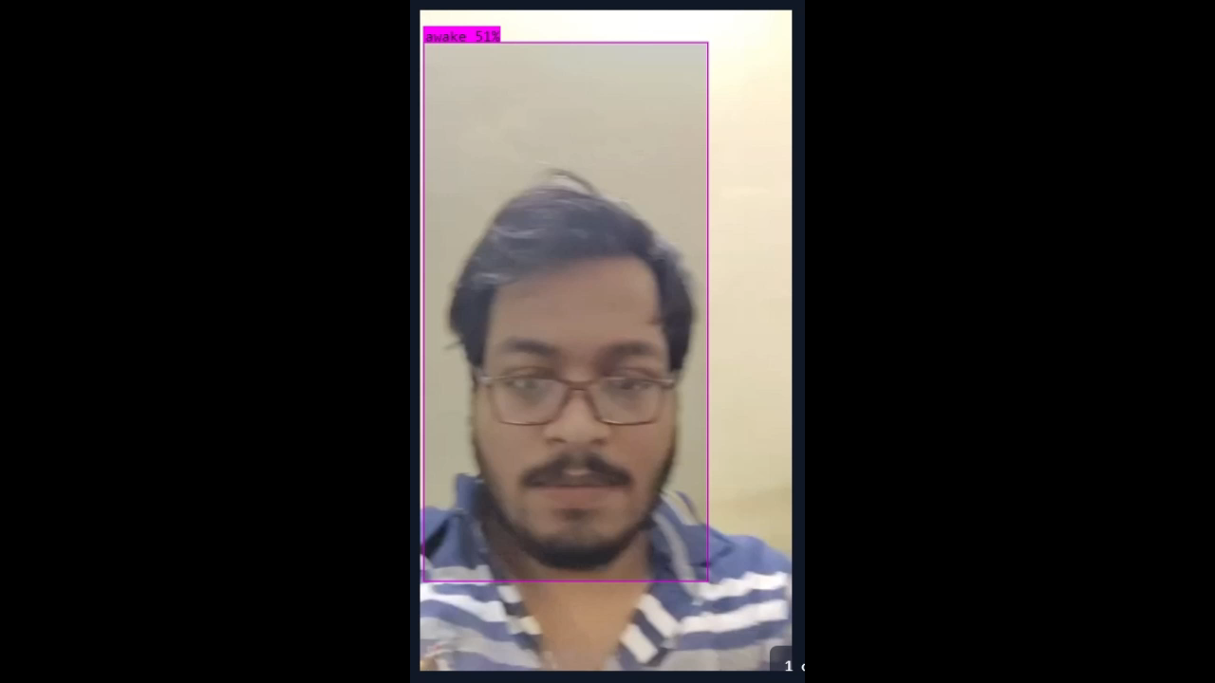

Deploying our Model on Mobile Phone
We deployed the given model on our Mobile Devices, with the help of TF-Lite (Tensor Flow Lite ). By converting our model into a TF-Lite format, we've significantly reduced its size while preserving its accuracy, ensuring efficient execution on your smartphones without compromising on performance. Even by reducing the given size of the model and optimizing it for the mobile phones, we were only able to use it on high-end mobile phones (example of mobile phone).

Slide 16
Comparison of our Model with Previous Works
Previous works have been done before on Mobile Deployment of Driver Drowsiness Detection System, and models that can run on Mobile Devices. Their performance in comparison to ours is given below-
Paper’s Model [7]
 | Model | Dataset | Accuracy | Inference Speed | GPU | RAM | CPU
Computer | YOLOv8 | 1 million images | 69.6% | 70 fps | Titan Xp 32 GB | 128 GB | AMD Ryzen Threadripper 1900X
Mobile Deployment | MobileNet_V2 | 1 million images | 71.8% | 15fps | -- | 8 GB | A17 Pro
Our Model
 | Model | Dataset | Accuracy | Inference Speed | GPU | RAM | CPU
Computer | RT-DETR | 10k images | 67.8% | 15 fps | NVIDIA GeForce RTX 1650 | 16 GB | Intel i5
Mobile Deployment | RT-DETR | 10k images | 65% | 5 fps | -- | 8GB | Snapdragon 7 Gen 3

Slide 17
Conclusion
Our given model gave decent results despite being trained on lesser data and executed on slower GPUs.
RT-DETR has been shown to outperform other real-time and end-to-end object detectors in terms of both speed and accuracy.
In summary, RT-DETR is a significant contribution to the field of object detection, combining the advantages of transformers and real-time processing.
Its development is supported by various funding sources, including the NIH and NSF, which have contributed to the advancement of computer vision and artificial intelligence.
It has performed really well on mobile devices and we aim to reduce the given inference time of the given model even further by optimizing the given model and using better computer vision techniques.
With developments in the computer vision field, we aim to reduce its inference time even further.

Slide 18
References
Albadawi, Y., Takruri, M., & Awad, M. (2022). A Review of Recent Developments in Driver Drowsiness Detection Systems. Sensors (Basel, Switzerland), 22(5), 2069. https://doi.org/10.3390/s22052069
R. K. M, R. V and R. G. Franklin, "Alert System for Driver’s Drowsiness Using Image Processing," 2019 International Conference on Vision Towards Emerging Trends in Communication and Networking (ViTECoN), Vellore, India, 2019, pp. 1-5, doi: 10.1109/ViTECoN.2019.8899627.
Poursadeghiyan, M., Mazloumi, A., Nasl Saraji, G., Baneshi, M. M., Khammar, A., & Ebrahimi, M. H. (2018). Using Image Processing in the Proposed Drowsiness Detection System Design. Iranian journal of public health, 47(9), 1371–1378.
Dosovitskiy, A., Beyer, L., Kolesnikov, A., Weissenborn, D., Zhai, X., Unterthiner, T., Dehghani, M., Minderer, M., Heigold, G., Gelly, S., Uszkoreit, J., & Houlsby, N. (2020). An Image is Worth 16x16 Words: Transformers for Image Recognition at Scale. ArXiv, abs/2010.11929.
https://docs.ultralytics.com/models/rtdetr/

